Slide 1
synthesizing programs that procedurally generate plant graphics
Caleb Winston
Mentored by Professor Rastislav Bodik
Programming Languages & Software Engineering (PLSE) Group

Slide 2

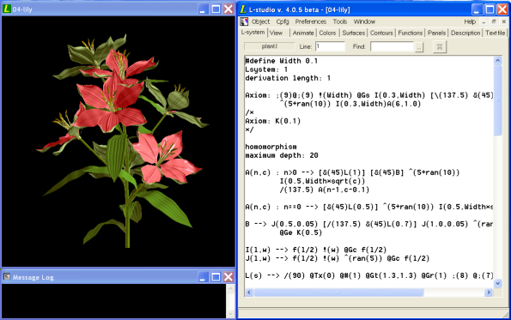
writing programs that generate lots of plant graphics is hard
Generated plants in virtual reality video game, No Man’s Sky
A program that can generate field of plants (right), one example of a generated plant that would belong to the field (left)

Slide 3
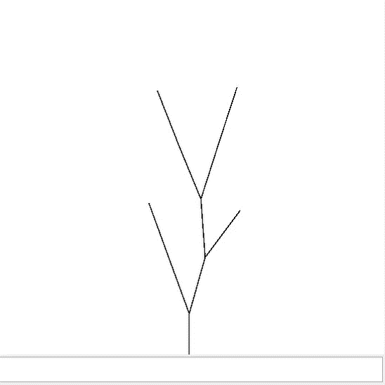
writing programs that generate lots of plant graphics is hard
(rule F FF)
(rule X F[[X]+X]+F
[+FX]-X]-X)
a program that generates graphics (an L-system)
graphics generated by program

Slide 4
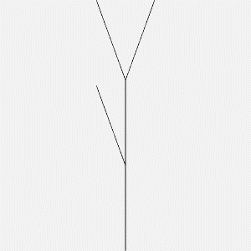
idea: make computer synthesize those programs from an example graphic provided by designer
(rule F FF)
(rule X F[[X]+X]+F
[+FX]-X]-X)
an example of a graphic that a designer wants the program to generate
a program that generates graphics (an L-system)
graphics generated by program

Slide 5
step 1: prune set of possible programs
(0) take infinite set of all programs
(rule F [)
(rule X [[[[)
(rule F F)
(rule X X)
(rule F XF)
(rule X X+ [-XF]]+X)
(rule F FF)
(rule X F[[X]+X]+F
[+FX]-X]-X)
(rule F XX)
(rule X F)

Slide 6
step 1: prune set of possible programs
(1) remove programs that generate invalid plant parts
(rule F [)
(rule X [[[[)
(rule F F)
(rule X X)
(rule F XF)
(rule X X+ [-XF]]+X)
(rule F FF)
(rule X F[[X]+X]+F
[+FX]-X]-X)
(rule F XX)
(rule X F)

Slide 7
step 1: prune set of possible programs
(1) remove programs that generate invalid plant parts
(rule F F)
(rule X X)
(rule F XF)
(rule X X+ [-XF]]+X)
(rule F FF)
(rule X F[[X]+X]+F
[+FX]-X]-X)
(rule F XX)
(rule X F)

Slide 8
step 1: prune set of possible programs
(1) remove programs that generate invalid plant parts
(rule F F)
(rule X X)
(2) remove programs that generate plant parts that don’t come from plant given by designer
(rule F XF)
(rule X X+ [-XF]]+X)
(rule F FF)
(rule X F[[X]+X]+F
[+FX]-X]-X)
(rule F XX)
(rule X F)

Slide 9
step 1: prune set of possible programs
(1) remove programs that generate invalid plant parts
(rule F F)
(rule X X)
(2) remove programs that generate plant parts that don’t come from plant given by designer
(rule F XF)
(rule X X+ [-XF]]+X)
(rule F FF)
(rule X F[[X]+X]+F
[+FX]-X]-X)

Slide 10
step 1: prune set of possible programs
(1) remove programs that generate invalid plant parts
(rule F F)
(rule X X)
(2) remove programs that generate plant parts that don’t come from plant given by designer
(rule F XF)
(rule X X+ [-XF]]+X)
(rule F FF)
(rule X F[[X]+X]+F
[+FX]-X]-X)
(3) Remove programs that generate plant parts that are too big

Slide 11
step 1: prune set of possible programs
(1) remove programs that generate invalid plant parts
(rule F F)
(rule X X)
(2) remove programs that generate plant parts that don’t come from plant given by designer
(rule F XF)
(rule X X+ [-XF]]+X)
(3) Remove programs that generate plant parts that are too big

Slide 12
step 1: prune set of possible programs
(1) remove programs that generate invalid plant parts
(rule F F)
(rule X X)
(2) remove programs that generate plant parts that don’t come from plant given by designer
(rule F XF)
(rule X X+ [-XF]]+X)
(3) Remove programs that generate plant parts that are too big
(4) smaller subset of possible programs

Slide 13
step 2: tell Rosette to constrain program
(Rosette is a framework for doing program synthesis, developed by Emina Torlak and Rastislav Bodik)
define symbolic expression for a program using pruned set of possible programs

Slide 14
but what is a symbolic expression?
4567 + 9021
45 + 982
345 + 1
1867 + 381

Slide 15
but what is a symbolic expression?
4567 + 9021
45 + 982
X + Y
345 + 1
1867 + 381

Slide 16
but what is a symbolic expression?
(rule F F)
(rule X X)
(rule F XF)
(rule X X+ [-XF]]+X)

Slide 17
but what is a symbolic expression?
(rule F F)
(rule X X)
(rule ??? ???)
(rule ??? ???)
(rule F XF)
(rule X X+ [-XF]]+X)

Slide 18
step 2: tell Rosette to constrain program
(Rosette is a framework for doing program synthesis, developed by Emina Torlak and Rastislav Bodik)
define symbolic expression for a program

Slide 19
step 2: tell Rosette to constrain program
(Rosette is a framework for doing program synthesis, developed by Emina Torlak and Rastislav Bodik)
define symbolic expression for a program
define symbolic expression for output plant graphics from program

Slide 20
step 2: tell Rosette to constrain program
(Rosette is a framework for doing program synthesis, developed by Emina Torlak and Rastislav Bodik)
define symbolic expression for a program
define symbolic expression for output plant graphics from program
define symbolic expression for # of edits between output plant graphic and plant graphic given by designer

Slide 21
step 2: tell Rosette to constrain program
(Rosette is a framework for doing program synthesis, developed by Emina Torlak and Rastislav Bodik)
define symbolic expression for a program
define symbolic expression for output plant graphics from program
define symbolic expression for # of edits between output plant graphic and plant graphic given by designer
tell Rosette that # of edits must be less than a certain number

Slide 22
step 3: ask Rosette for solution program
tell Rosette to solve for program that satisfies constraint for # of edits
Rosette compiles the constraints for a program to a Satisfiability Module Theory
Rosette solves for a solution
Rosette uses solution to derive expression for solution program

Slide 23

demo

Slide 24
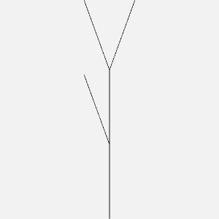
in summary…
I developed a synthesizer for programs that generate plant graphics
given an example plant graphic, our tool will find a program that generates similar graphics
(rule F FF)
(rule X F[[X]+X]+F
[+FX]-X]-X)
an example of a graphic that a designer wants the program to generate
a program that generates graphics (an L-system)
graphics generated by program

Slide 25
acknowledgements
Professor Ras Bodik, Paul G. Allen School of Computer Science & Engineering
Programming Languages & Software Engineering Group, Paul G. Allen School of Computer Science & Engineering

